Slide 1
An AI-Based Sign Language Translation System
Team 14: Kausha Trivedi, Devashish Mahurkar, Mrigank Khandelwal, Julia Gumieniak

Slide 2
Problem Statement
Fundamental human right
Social well being of the global community of - the deaf and hard of hearing
Dismantling communication barriers
Rapid and inclusive interactions

Slide 3
What We Did To Solve It
ASL dataset
CNN Training
Pegasus - transforming signs into sentences

Slide 4
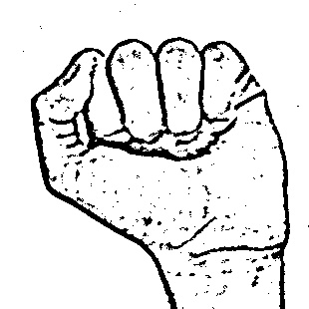
Dataset
Assigning characters
Pre existing data augmentation
Diverse dataset reduces overfitting

Slide 5
Part 1: Classification
A sign detector detects letters.
We have trained CNN model and saved it.
CNN - prowess in image recognition
How did we classify?

Slide 6
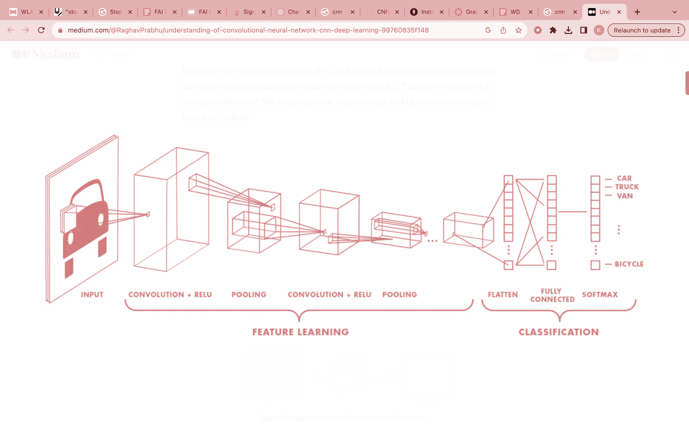
Architecture of CNN

Slide 7
Part 2: Paraphrasing

Slide 8
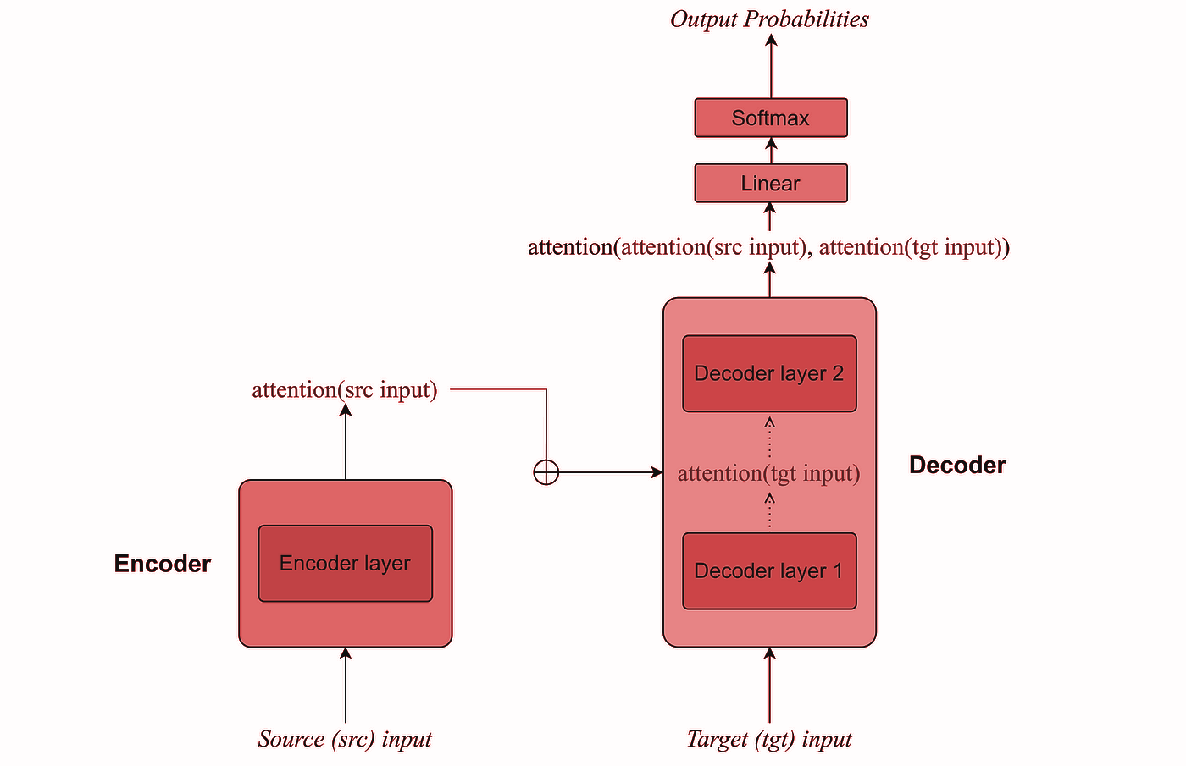
Transformers
Sequence - to- Sequence Neural Network
Trained on massive text corpuses
Has an encoder and decoder
Self-Attention Mechanism (Learns Context)

Slide 9
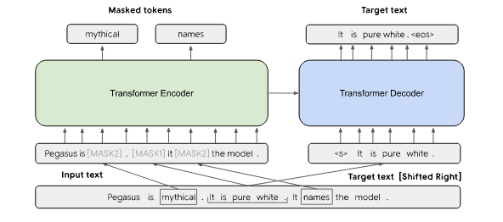
Pegasus
Masked Language Model encoder (MLM)
Gap sentence Generation decoder(GSG)
SOTA for Abstractive Summarization

Slide 10
Part 2: Paraphrasing
Tried fine tuning the Google Pegasus-Large base model to Microsoft Research Paraphrase Corpus (MRPC).
Input: new england rain today
Output: the new englands patriots game today has been cancelled due to rains
Tried using an already fine tuned Pegasus Model called Tuner007.
Input: new england rain today
Output: There was rain today in Boston

Slide 11
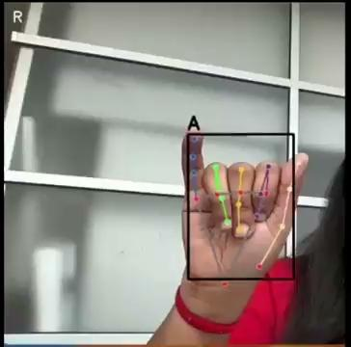
Demo

Slide 12
Conclusion
We developed an AI based language translation system.
CNN and Pegasus.
Signing words and auto generation.
In the future, we can expand to include more sign languages.

Slide 13
Thank You! Any questions?

